Slide 1
Will we be homeless?Housing prices
Made By
Tabrez Zahoor
Jacob Nyamu
Zainab Huda

Slide 2
Problem Statement
The rising cost of housing in Boston has become a major concern for many individuals and families, fueling their fear of becoming homeless. People are finding it difficult to afford adequate living arrangements due to rising housing prices, putting them at risk of losing their homes and potentially becoming homeless. This issue not only affects individuals and families, but also has broader societal and economic implications, such as increased poverty and decreased access to education and healthcare

Slide 3
Steps and Conclusion
Performed linear regression on the data using the year, month, and day columns as predictors and the price column as the target variable.Several operations on the data such as selecting specific rows, dropping columns, transposing the data frame, converting a column to datetime format, and extracting year, month, and day from the datetime column. The model predicts the price for December 31st, 2023 as 553609.
The descriptive statistics of the Inventory csv was also analyzed and line plot was created accordingly to show the Boston housing inventory over the years.
The conclusion made with the analysis is there is a constant rise in the price of the houses. And, the analysis from inventory further supports by showing the declining number of houses over the years. Thus , fear of homelessness is real, and it is important to find solutions to this problem in order to ensure that everyone has access to affordable and stable housing.

Slide 4
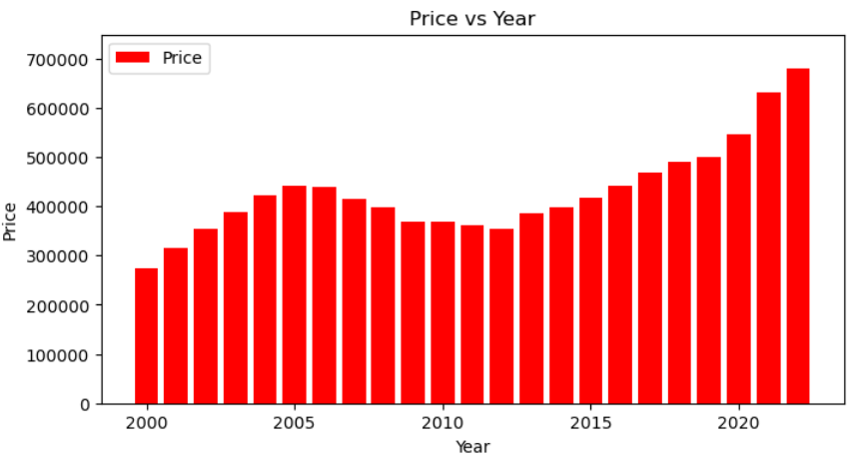
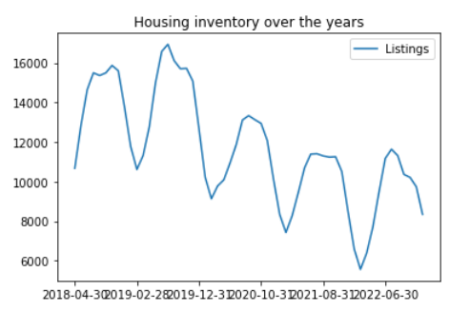
Graphical analysis of price and housing inventory over the years

